Slide 1

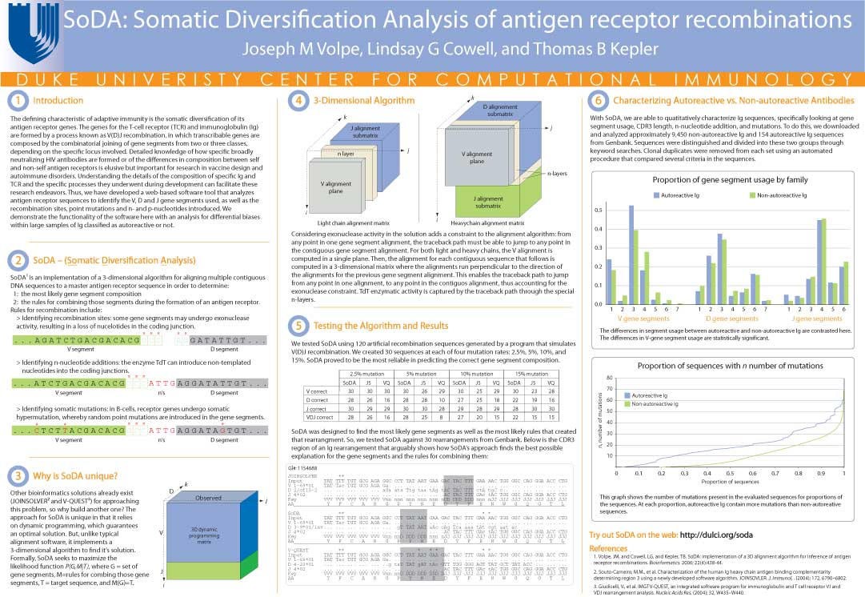


Tetranucleotide usage in mycobacteriophage genomes: alignment-free methods to cluster phage and infer evolutionary relationships Chen Ye, Benjamin Siranosian, Emma Herold, Minjae Kwon, Sudheesha Perera, Edward Williams, Sarah Taylor, Christopher deGraffenried
BROWN UNIVERSITY PHAGE HUNTERS
1
Alignment-free analysis
3
Phylogenetic trees
6
Conclusions
4
Exceptional 4-mers
2
Methods
5
Genomic self-similarity
Evidence of horizontal gene transfer?
Kmer counting
Tetranucleotide usage deviation
Tetranucleotide Difference Index
Some homology
JoeDirt gp 130
Mycobacterium abscessus E = 2e-48
Flavobacterium psychrophilum E=2e-28
Streptomyces sp. E = 4e-28
Opitutaceae bacterium TAV1 ATPase E = 1e-23
Investigate with
7
Future directions
Phamerator
BLAST
Developing a Naïve Bayes classifier to quantify gene exchange
Investigating oligonucleotide usage similarities and differences between hosts and phage
More likely:
JoeDirt (L1) cluster of repeats at 70kb
Archie (L2) cluster of repeats at 74kb and 76kb
Additional information:
Source code and processed data is available at
Github.com/bsiranosian/tago
Bsiranosian.com
Cluster L genomes are very repetitive at the end.
Repetitive regions have increased counts of specific 4-mers, contributing to the spike in TDI.
70000
74000
76000
Literature Cited
Acknowledgements
We are grateful to Dr. Peter Shank, Dr. Sorin Istrail, Dr. Zhijin Wu, HHMI’s SEA program and the University of Pittsburgh.

